Slide 1



Lecture 4: Building and honing your skills
GAM340: Professional Practice
BA(Hons) Game Development

Slide 2
Learning Outcomes
Analyse media to discover cues about required, desired and nice to have skills
Investigate on-line and off-line approaches and techniques to develop your skills
Discuss methods of highlighting your skills within portfolio and promotional materials

Slide 3
What skills do you actually need / want to develop?
Job’s ‘joining the dots’ (Lecture 1)
Know yourself, plan yourself (Lecture 1)
Where are you at?
Where do you want to be?
How are you going to get there?

Slide 4
What skills do you actually need / want to develop?
What can you be, what can job ads actually tell us
Looked at ads in GamesIndustry.biz
‘entry level’ / junior roles
Q3 (Oct-Dec) is never good for recruitment
People start going on holiday, Dec is a washout
Often, budgets are confirmed for Q2(Apr-Jun)
Recruitment follows budgets
Companies aware of graduation in May/June, gear towards that

Slide 5
What skills do you actually need / want to develop?
Art
https://jobs.gamesindustry.biz/gamer-network/uk-and-europe/junior-graphic-designer---artworker-gamer-network-id105393
https://jobs.gamesindustry.biz/big-planet/uk-and-europe/junior-vfx-artist-aaa-games-cheshire-uk-id110110
https://jobs.gamesindustry.biz/kwalee/leamington-spa/midlands/united-kingdom/uk-and-europe/junior-games-artist-id96538

Slide 6
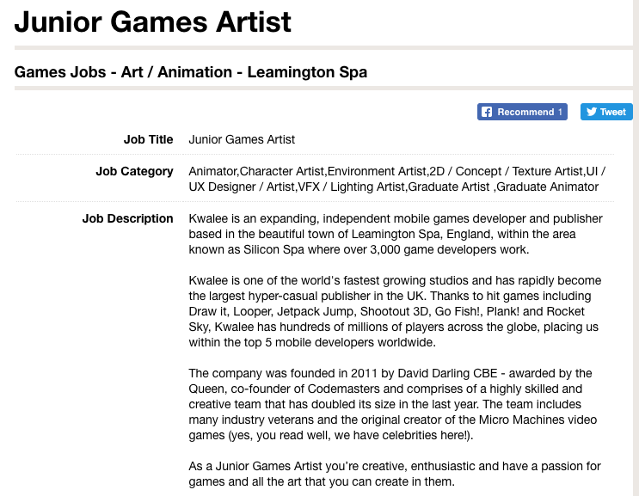
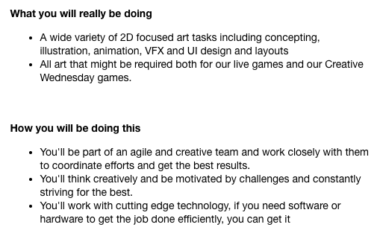
What skills do you actually need / want to develop?
https://jobs.gamesindustry.biz/kwalee/leamington-spa/midlands/united-kingdom/uk-and-europe/junior-games-artist-id96538

Slide 7
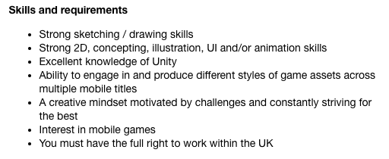
What skills do you actually need / want to develop?
https://jobs.gamesindustry.biz/kwalee/leamington-spa/midlands/united-kingdom/uk-and-europe/junior-games-artist-id96538

Slide 8
What skills do you actually need / want to develop?
https://jobs.gamesindustry.biz/kwalee/leamington-spa/midlands/united-kingdom/uk-and-europe/junior-games-artist-id96538
Effectively
‘concepting’ -> good at life drawing, traditional media
Digital drawing / illustration
Some graphic design
‘animation’ (probably 2D)
Unity ‘knowledge’ (UI work?)

Slide 9

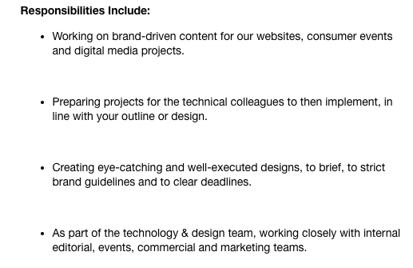
What skills do you actually need / want to develop?
Art
https://jobs.gamesindustry.biz/gamer-network/uk-and-europe/junior-graphic-designer---artworker-gamer-network-id105393

Slide 10
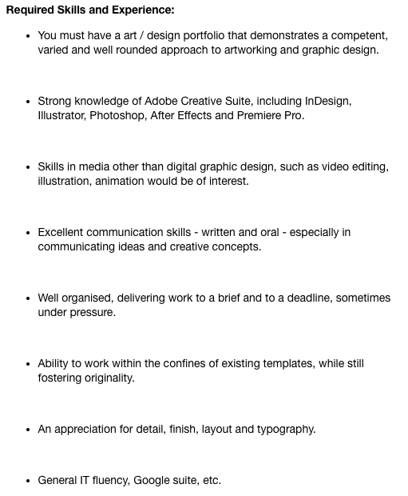
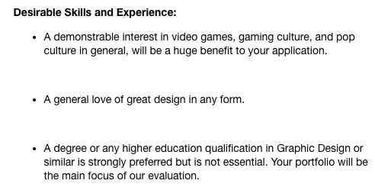
What skills do you actually need / want to develop?
Art
https://jobs.gamesindustry.biz/gamer-network/uk-and-europe/junior-graphic-designer---artworker-gamer-network-id105393

Slide 11
What skills do you actually need / want to develop?
Art
https://jobs.gamesindustry.biz/gamer-network/uk-and-europe/junior-graphic-designer---artworker-gamer-network-id105393
Effectively
Gamer Network is a website, this role is making visual content
‘graphic design’
Adobe CS (InDesign, Photoshop, Illustrator, Premier)
‘your portfolio will be the main focus of our evaluation’

Slide 12

What skills do you actually need / want to develop?
Art

Slide 13
What skills do you actually need / want to develop?
Art
Effectively
You love VFX
And not in real time engines either (Maya)

Slide 14
What skills do you actually need / want to develop?
Art
In general
Key technical packages (Maya, Unreal/Unity, Abode Creative Suite)
Get good at using these
Key skills depend on what you want to do
3D modelling / materials
2D work
VFX
Concepting
etc

Slide 15
What skills do you actually need / want to develop?
Programming
https://jobs.gamesindustry.biz/sumo-digital/uk-and-europe/junior-programmer-the-chinese-room--brighton-id108358
https://jobs.gamesindustry.biz/datascope/uk-and-europe/junior-c--wpf-programmer---london----35-000-id109364
https://jobs.gamesindustry.biz/opm/uk-and-europe/graduate-gameplay-programmer-andndash--cross-platform-andndash--north-west-uk-id95234

Slide 16
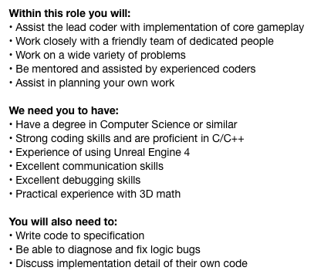
What skills do you actually need / want to develop?
Junior Programmer - THE CHINESE ROOM, BRIGHTON
Effectively
Can you code in C++
Can you use Unreal
Do you know maths

Slide 17
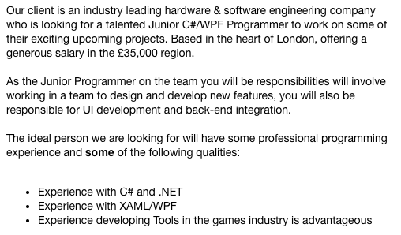
What skills do you actually need / want to develop?
Junior C#/WPF Programmer – London
Effectively
Can you code in C#
Can you write tools in XAML
Do you <3 tools?

Slide 18
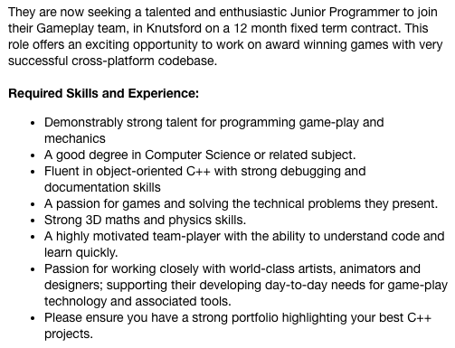
What skills do you actually need / want to develop?
Graduate Gameplay Programmer – Cross-platform – North West UK
Effectively
Can you do gameplay coding?
In C++
Do you know / like maths?

Slide 19
What skills do you actually need / want to develop?
Programming
In general
Key technical packages
C++ / C#
Unreal / Unity (games)
C# / XAML / forms (tools & apps)
Fullstack tech (webdev)
Key skills depending what you want to do
Writing software
Debugging software
An appreciation of maths (physics)

Slide 20
What skills do you actually need / want to develop?
Design
https://jobs.gamesindustry.biz/datascope/uk-and-europe/game-designer--junior--malta-20-32k-eur---benefits-id109963
https://jobs.gamesindustry.biz/amiqus-games/liverpool/north-west/united-kingdom/uk-and-europe/technical-designer-id107134
https://jobs.gamesindustry.biz/big-planet/north/united-kingdom/uk-and-europe/uk-s-90--metacritic-aaa-racing-studio-hiring-track-designer-id79923

Slide 21
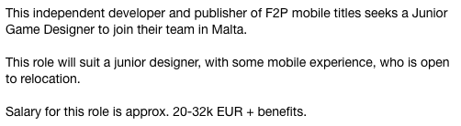
What skills do you actually need / want to develop?
Game Designer (junior) - Malta - 20-32k EUR + benefits
Effectively
Do you know/care about F2P mobile games?

Slide 22
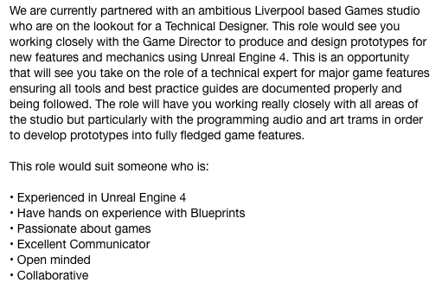
What skills do you actually need / want to develop?
Technical Designer
Effectively
Do you know blueprints?
Do you want to make prototypes?

Slide 23

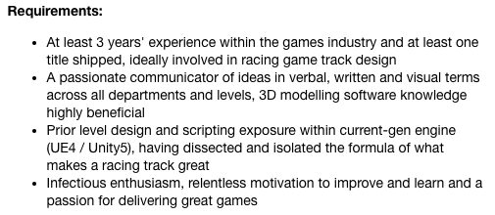
What skills do you actually need / want to develop?
UK's 90% Metacritic AAA Racing Studio hiring Track Designer
Effectively
Are you interested in racing / racing tracks?

Slide 24
What skills do you actually need / want to develop?
Design
In general
Key technical packages
Unreal / Unity (games)
Often Adobe CS for presentation / pre-viz
Scope for ‘programming’ / blueprints
Key skills depending what you want to do
Building levels (white box / grey box / block out)
Creating gameplay
Communication with others (programmers / design managers)
(often) writing
(sometimes) drawing & graphic design

Slide 25
What skills do you actually need / want to develop?
Animation
https://jobs.gamesindustry.biz/oxford-medical-simulation/united-kingdom/uk-and-europe/technical-animator-id107931
https://jobs.gamesindustry.biz/datascope/uk-and-europe/3d-animator--london--mobile---35-000---benefits-id109931

Slide 26

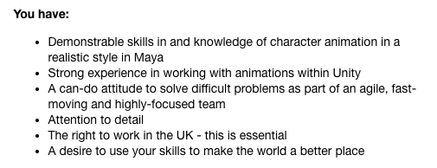
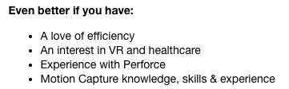
What skills do you actually need / want to develop?
Technical Animator
Effectively
Do you want to do animation for medical visualisation
Rigging, skinning, scripting
Optimisation
Healthcare / VR ‘nerd’

Slide 27
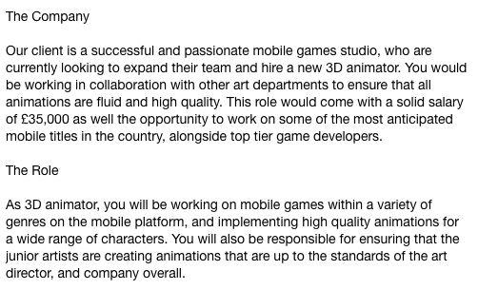
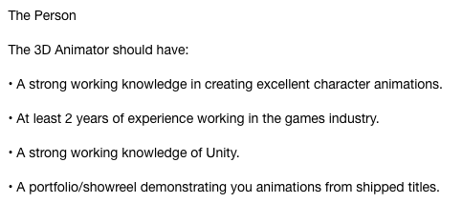
What skills do you actually need / want to develop?
3D Animator, London, Mobile, £35,000 + Benefits
Effectively
Are you good at animation
Can you lead inexperienced animators
Are you aware of mobile animation issues

Slide 28
What skills do you actually need / want to develop?
Animation
In general
Key technical packages
Maya
Mocap
Unity / Unreal animation
Key skills depending what you want to do
Rigging
Skinning
Doing animation / working with mocap
Working with programmers / designers

Slide 29
What skills do you actually need / want to develop?
Audio
https://jobs.gamesindustry.biz/sumo-digital/anywhere/sound-designer-sumo-sheffield-id100072

Slide 30
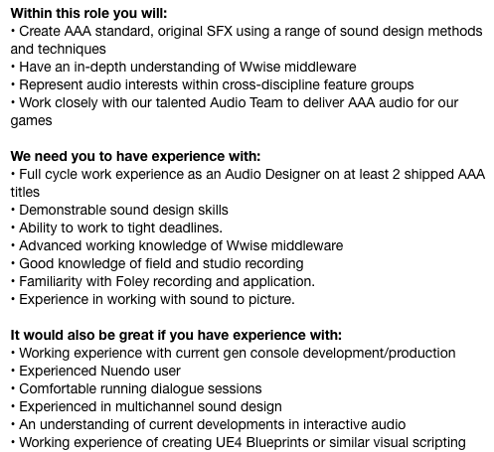
What skills do you actually need / want to develop?
Sound Designer - SUMO SHEFFIELD
Effectively
Creating audio assets
Using wwise
Blueprints

Slide 31
What skills do you actually need / want to develop?
Audio
In general
Key technical packages
Unity / Unreal
Wwise & other audio frameworks
Audio synthesis / processing tools
Key skills depending what you want to do
Making assets
Processing assets
(Some) prototyping in engine
Working with programmers / designers

Slide 32
What skills do you actually need / want to develop?
Writing
https://jobs.gamesindustry.biz/gamer-network/brighton/south-east/united-kingdom/uk-and-europe/news-reporter-rock--paper--shotgun-id109392
https://jobs.gamesindustry.biz/opm/amsterdam/the-netherlands/uk-and-europe/copy-writer-andndash--netherlands-andndash--permanent-andndash--aaa-online-games-id110012

Slide 33
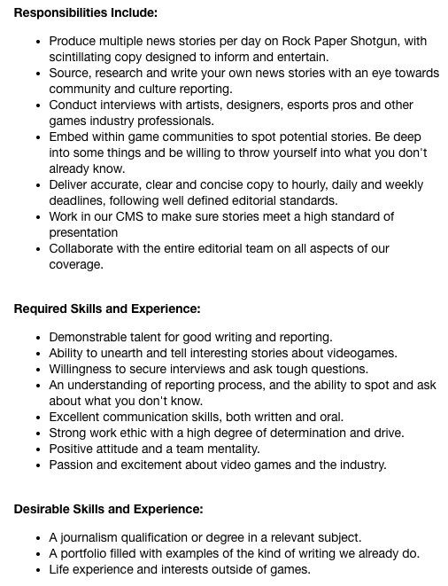
What skills do you actually need / want to develop?
News Reporter - Rock, Paper, Shotgun
Effectively
Do journalism at a well-known gaming website
Can you deliver content to schedule

Slide 34
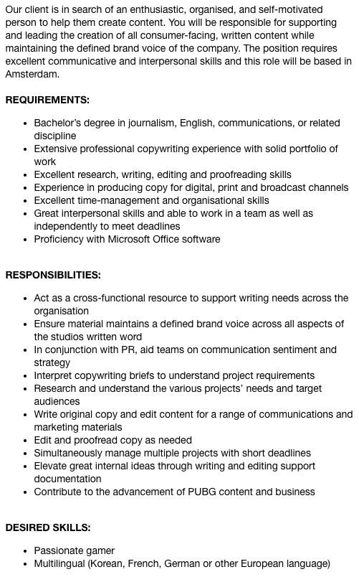
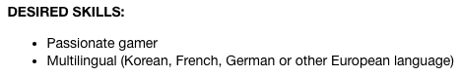
What skills do you actually need / want to develop?
Copy Writer – Netherlands – Permanent – AAA Online Games
Effectively
PUBG
Can you deliver content to schedule

Slide 35
What skills do you actually need / want to develop?
Writing
In general
Key technical packages
Office
(for games) writing technologies (fungus, ink, Twine)
Key skills depending what you want to do
Interpersonal skills
Presentation skills
Working with difficult people
Working across disciplines

Slide 36
What skills do you actually need / want to develop?
Core set of skills for most areas of games development and beyond
A lot of them are ‘soft’ skills
For ‘hard’ skills
Use your portfolio and portfolio time to develop the ones you ‘care’ about
By care, the ones that mean something to you:
What you enjoy
What you want to do

Slide 37
Emotional Intelligence

Slide 38
Emotional Intelligence
Goleman’s work looked at the relationship between levels of EI and ‘success’
Often emotional intelligence mattered more than technical expertise or QI
‘What you know is not more important than who you know’
‘How you get on with those you know’
‘we like to work with people we like’

Slide 39
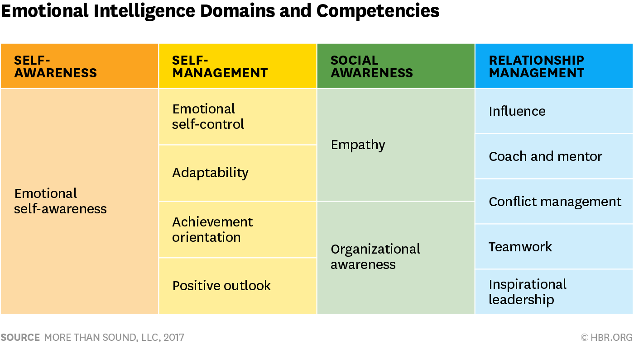
Emotional Intelligence

Slide 40
Emotional Intelligence
Self-awareness
Be aware of the impact of your words and deeds on others
See Toby Young ...

Slide 41
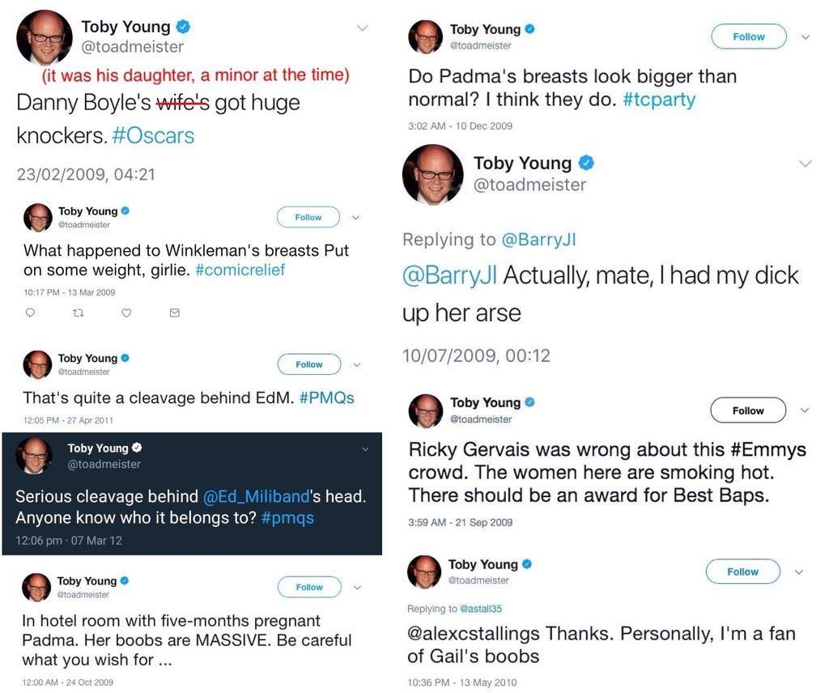
Emotional Intelligence

Slide 42
Emotional Intelligence
Self-management
You don’t have to say everything you think
You don’t have to fly off the handle at every opportunity
You don’t have to tell everyone that everything will be a disaster

Slide 43
Emotional Intelligence
Social awareness
Empathy: try and have some understanding of what other people are going through
Be aware of the structures that you operate in
Where are the sources of power?

Slide 44
Emotional Intelligence
Relationship Management
How can you help and work with others
Everyone takes their own route through their studies
You all have your own skills
And can improve them by helping others
You all have roles to play in the teams and groups that you are in
These can be dynamically assigned / adopted

Slide 45
Emotional Intelligence
EI is not universal
Some MBTI types are more in tune
(xxFP) Feeling / Perceiving types
Vs
(xxTJ) Thinking / Judging
INFP
INTJ

Slide 46
Emotional Intelligence
EI is not universal
Likewise for Belbin roles
LOWER
HIGHER

Slide 47
Honing your skills: How to ‘git gud’

Slide 48
Honing your skills
From Barbora’s question last week:
It’s not enough to suggest you all git gud
Commercial games are generally
Made by lots of people
With lots of experience (those 10,000 hours of deliberate practice)
Often in destination roles
In highly specialised roles
Supporting each other
Collaborating & iterating

Slide 49

Honing your skills
From Barbora’s question last week:
It’s not enough to suggest you all git gud
Professionals in the public eye are:
Often outliers
Notch, Mike Bithell, Molyneux
Often have *very* good PR in place
Molyneux

Slide 50
Honing your skills
From Barbora’s question last week:
It’s not enough to suggest you all git gud
How to not collapse under the weight of all those expectations?
Choose your developmental targets carefully
The guitarist problem
The elephant problem
Remember that you should be enjoying this (Job’s and ‘do what you love’)

Slide 51
Honing your skills
From Barbora’s question last week:
It’s not enough to suggest you all git gud

Slide 52
Honing your skills
From Barbora’s question last week:
It’s not enough to suggest you all git gud
Jonathan Hemmens work is a good example
The end results of processes
https://80.lv/articles/001agt-004adk-teens-room-interior-production/
This explains the breakdown
Break this down and iterate the parts
‘I want to get better at modelling X’ rather than the entire scene in one go
This is Gladwell’s deliberate practice and discipline independent

Slide 53
Honing your skills
From Barbora’s question last week:
Often good to have something to compete against
Picasso painted Les Demoiselle d’Avignon in response to Maitesse and Les Fauve group
Developed off ‘hundreds of sketches and studies’

Slide 54
Honing your skills
From Barbora’s question last week:
Very good to have feedback
This really ties into EI
How can you be critical of work without upsetting the recipient of your criticism?
How can you develop a resilience to ‘have another go’

Slide 55
Honing your skills
From Barbora’s question last week:
Very good to have feedback
Action Learning Sets can help
https://en.wikipedia.org/wiki/Action_learning
Form a small group (<5)
Meet frequently to discuss what you are doing & how you’re doing it
Revan’s talks about open and closed questions
Closed for information
Open to think, discuss and reflect
Similar to de Bono’s thinking hats
https://en.wikipedia.org/wiki/Six_Thinking_Hats

Slide 56
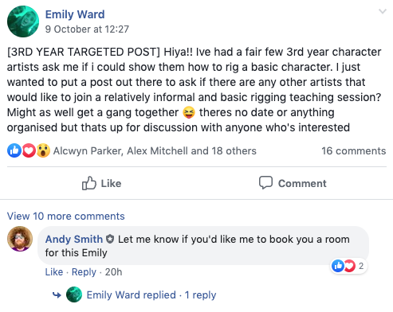
Honing your skills
From Barbora’s question last week:
Offer your expertise

Slide 57
Honing your skills
From Barbora’s question last week:
Hassle your route tutors for expertise
Programmers are now learning C++ for programming tests

Slide 58
Honing your skills
From Barbora’s question last week:
Leverage the internet and its vast amount of learning resources
Youtube / Social Media / ArtStation / 80.lv etc
LinkedIn Learning
Formally Lynda.com (you have accounts)
Now moved to LI, hundreds of thousands of hours of taught materials
Ideal for directed learning
Can put achievements on your linkedin profiles
MOOC
coursea.org, open.edu, futurelearn.com
Again, vast amounts of directed (video) learning
Unity / Unreal / Maya learning resources

Slide 59
Wrap-up
Different jobs require different skills
However, there’s lots of crossover
Particularly for the ‘10 graduate skills’ website
Now is not a great time for job ads, but there are ones out there
And there will be plenty more in the new year
Often worth looking for graduate roles that are similar to games roles but in other areas
Apply into games once you have some meaningful experience (18mths – 2yrs)
It’s a much easier route

Slide 60
Wrap-up
Developing your skills
Really can be daunting
Find tasks that fit your current level of expertise
Push yourself in small & incremental steps
Use your colleagues and staff to help you develop
Develop you EI to deal out and cope with feedback
Remember there are many sources of development, not least interweb resources.
Look at the portfolio potential of everything you do
It doesn’t all have to go on your portfolio, but you will have more choice in what you choose from

Slide 61
Questions

